Slide 1
Urban Ministries of Durham
By Jesus E. Vazquez
October 7, 2019

Slide 2
Background
Urban Ministries of Durham assist around 6,000 people each year who need food, shelter, clothing and/or supportive services. Some of the programs that they offer is a
community shelter where people are given a place to sleep and assistance to help them find a home, a
Community Café serves three meals a day, seven days a week, 365 days a year
(3) food and clothing closet for those that either need food or clothing. Donations, just to as any homeless shelter, are important to maintain services, therefore communicating the importance of donations should be a high priority.

Slide 3
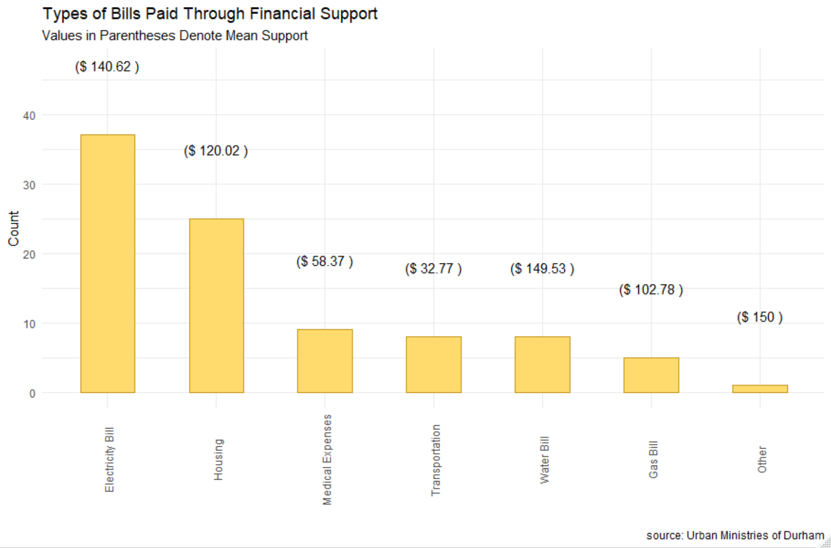
How is financial support to members of the Urban Ministries of Durham used?
As observed from the plot above we can see that among those given financial support, most of the bills paid were electricity bills with an average of $140.62 per bill.

Slide 4
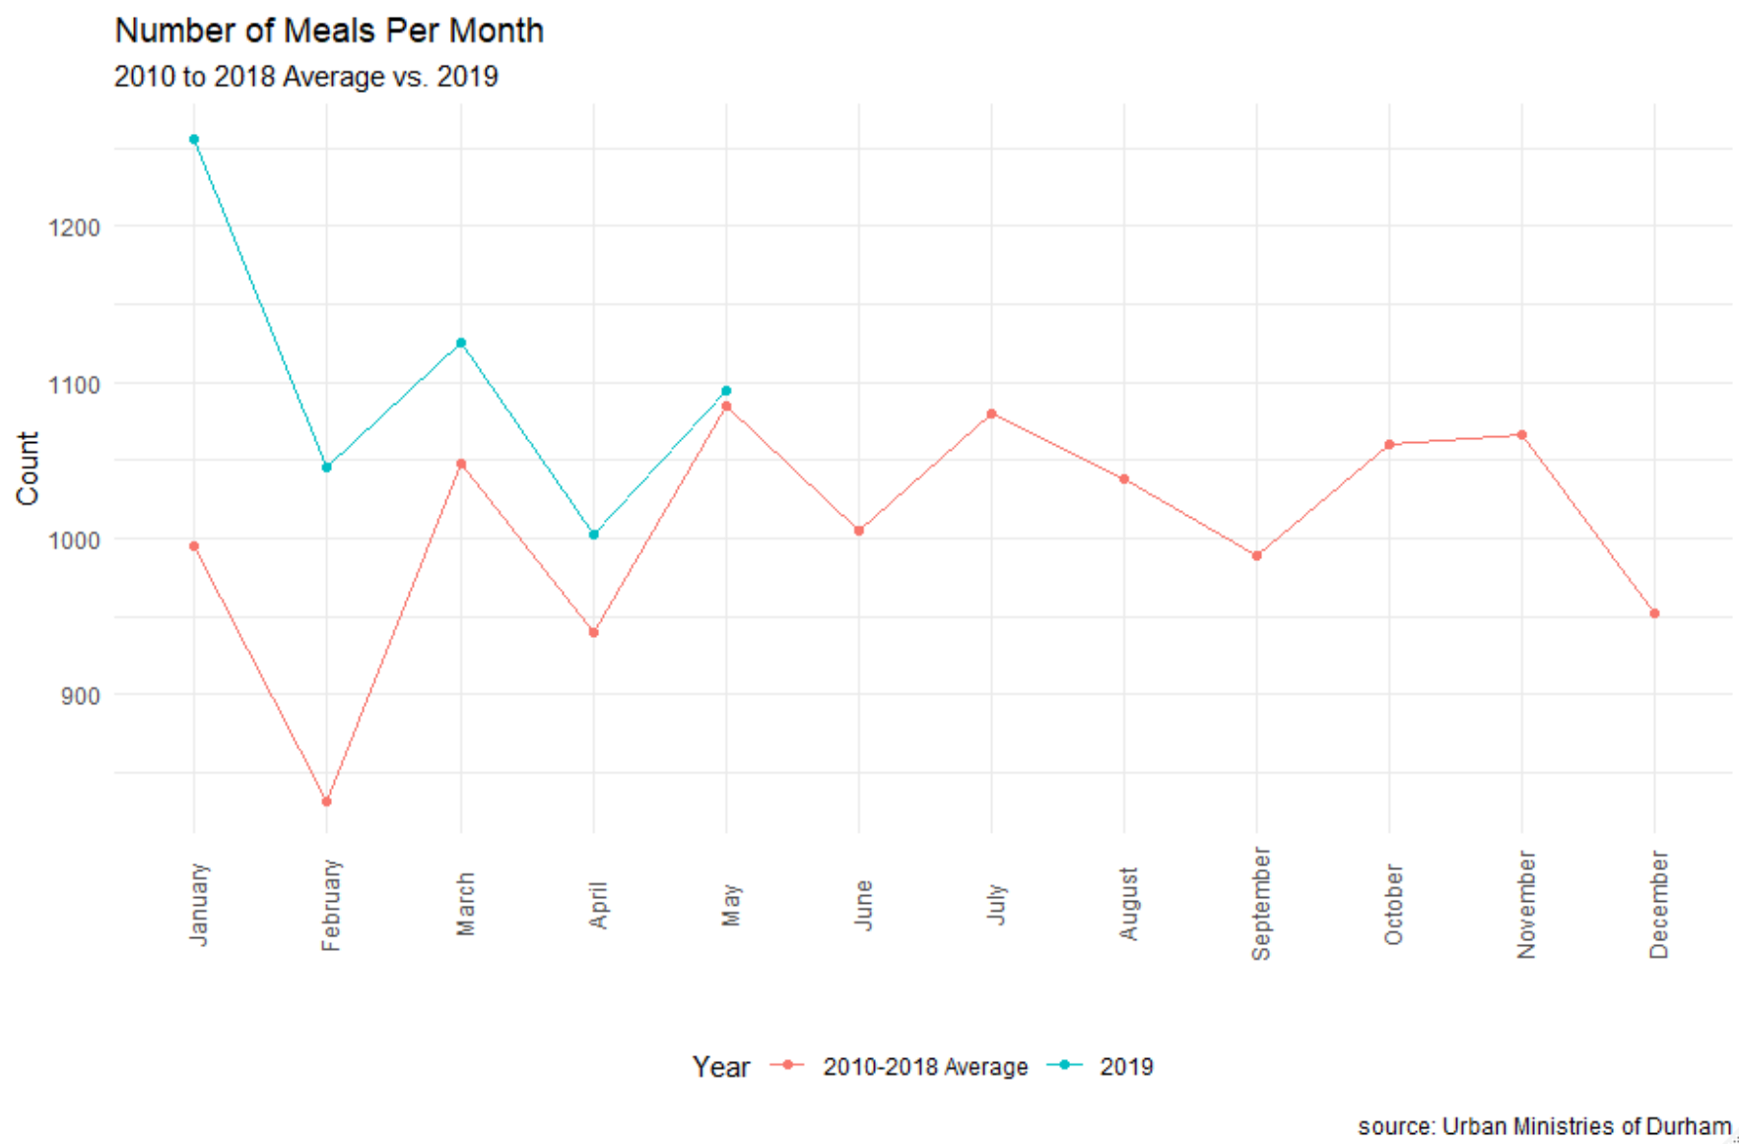
What time of the year do members among the community make use of the Community Café?
As we can observe the Urban Ministries of Durham has been serving about their 2010-2018 average so it's highly important for communicate the need for support.

Slide 5
Summary
As the plots suggest, financial assistance helped members of the Urban Ministries of Durham pay for basic necessities such as electricity and water bills. Given that money used for financial assistance was not misused, the services should come back.
2019 has observed a larger number of meals served per month thus it will also be of interest for the Urban Ministries of Durham to prepapre to serve more meals for the rest of the year.

Slide 6
Thank you!
Questions?

